Slide 1
INTRODUCTION TO PSYCHOLOGY (WEEK 1)
BY: Rabia Ejaz
LECTURER
(SCIENCE AND HUMANITIES)
FAST - National University of Computer & Emerging Sciences

Slide 2
LEARNING OUTCOMES
Understanding the meaning of Psychology
Psychology as a science
Scope of psychology
Goals of Psychology
Key debates in Psychology
Branches of Psychology

Slide 3
VIDEO
https://www.youtube.com/watch?v=vo4pMVb0R6M

Slide 4

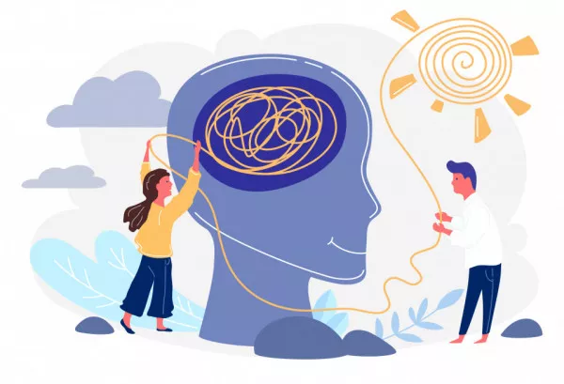
Definition:
Psychology is the scientific study of behavior and mental processes.
The word "psychology" comes from the Greek word psyche meaning "breath, spirit, soul", and the Greek word logos meaning the study of something. Thus we can conclude that psychology is the study of soul.
Psychology is an offspring of subject philosophy.
Behavior: Outward or overt actions and reactions (observable)
Example: running, smiling, dancing, talking
Mental Processes: all internal, covert activity of mind (hidden)
Example: thoughts, dreaming, sensations, feelings

Slide 5
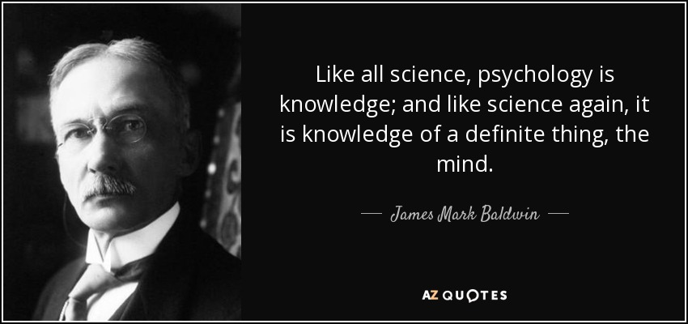
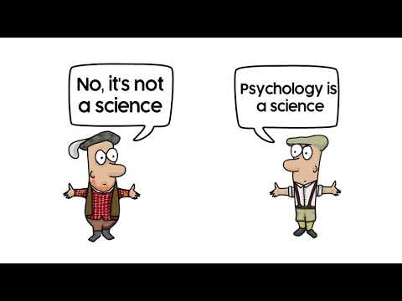
Psychology as a Science:
Psychology is a science because it uses the scientific method, which is a set of procedures designed to establish general (universal) laws by collecting facts and evaluating theories that attempt to describe, explain, and predict phenomena.
All sciences have to follow the above mentioned steps.
Psychologist systematically collect and examine data (empirical evidence) to support or disprove hypotheses (predictions) rather than depending on common sense.

Slide 6
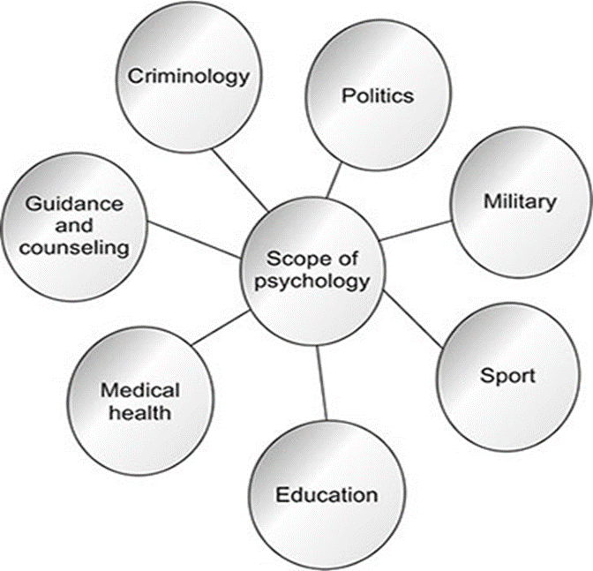
SCOPE OF PSYCHOLOGY
Psychology today covers enormous range of scope or fields.
Basic psychology: it is the study of mind and behavior
Applied psychology: methods and findings of scientific psychology to solve practical problems of human and animal behavior and experience.
Notes:
Basic psychology: purely theoretical, with the intent of increasing our understanding of certain phenomena or behavior but without seeking to solve or treat these problems.
Eg: A study looking at how caffeine consumption impacts the brain
A study assessing whether men or women are more likely to be diagnosed with depression
A study looking at how attachment styles among children of divorced parents compare to those raised by married parents
Applied psychology: involves taking known psychological theories and principles to solve problems being experienced within other areas or fields
Many psychological studies on addiction reveal that the main cause of addiction is the stress factor.

Slide 7
THINK????
How is psychology important in your field?
What makes psychology important in your field?

Slide 8

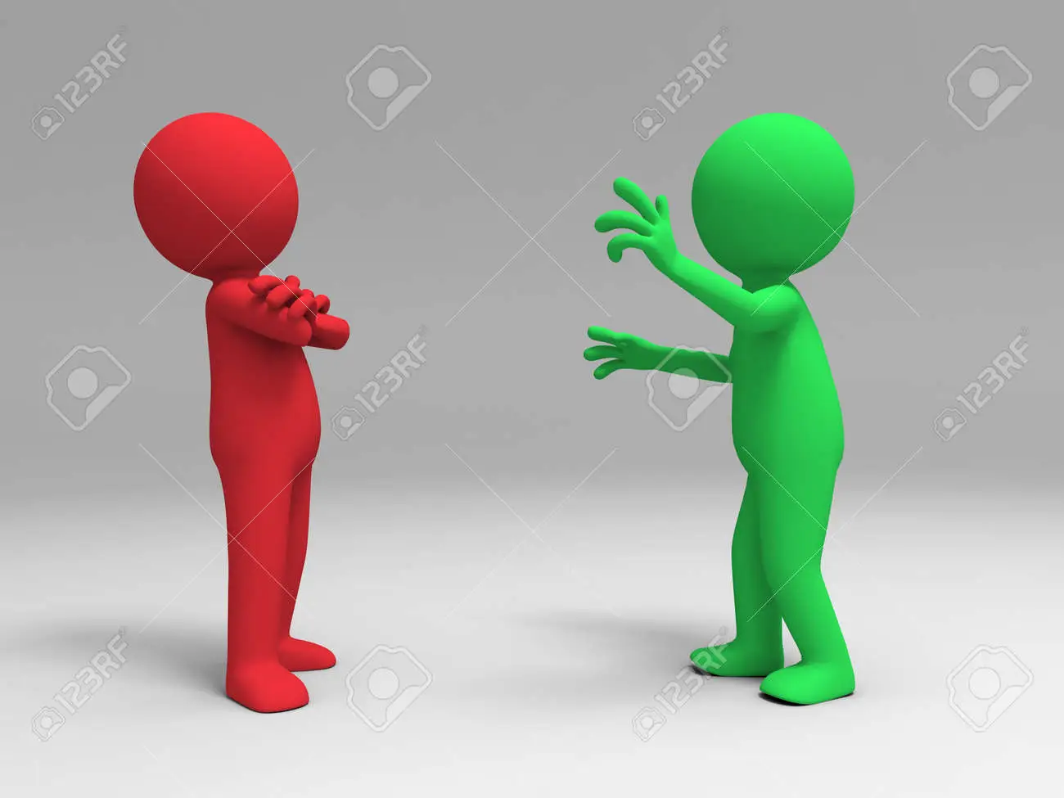


GOALS OF PSYCHOLOGY
TO DESCRIBE
(What is Happening?)
- Observing a behavior and taking note of everything that is happening.
TO EXPLAIN (Why is it happening?)
-Behavior is being understood by explaining it.
TO PREDICT (Will it happen again?)
-Determining what will happen in the future
TO CONTROL (How can it be changed?)
-To change a behavior from an undesirable one to a desirable one.
Notes:
Example: Child showing tantrums

Slide 9
CONT.…
To describe what is an organism doing?
To explain and understand why organism behave in certain ways?
To predict how organism will behave in the future?
To control behavior or to modify the particular behavior?

Slide 10
KEY DEBATES IN PSYCHOLOGY
Nature vs. Nurture
Conscious vs. Unconscious Mind
Observable behavior vs. internal mental Processes
Free will vs. determinism
Individual Differences vs. universal Principles
These key debates are used to understand how culture, ethnicity, and race influence behavior.

Slide 11
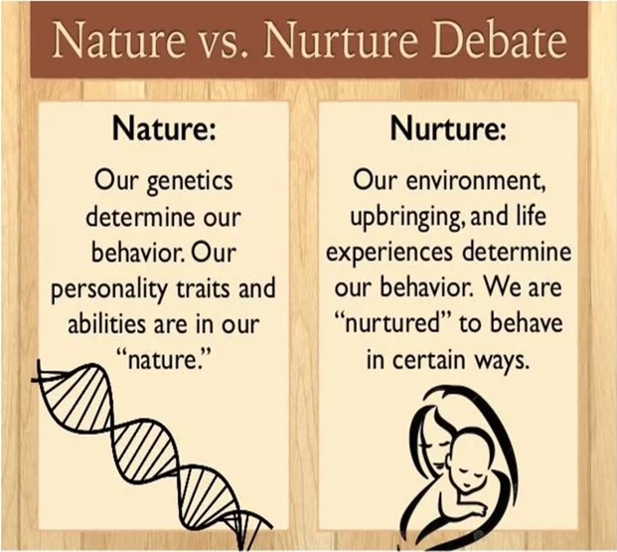
1. NATURE VS NURTURE
Heredity vs environment
How much people's behavior is due to their genetically determined nature
VS
How much is due to the influences of the physical and social environment in which a child is raised

Slide 12
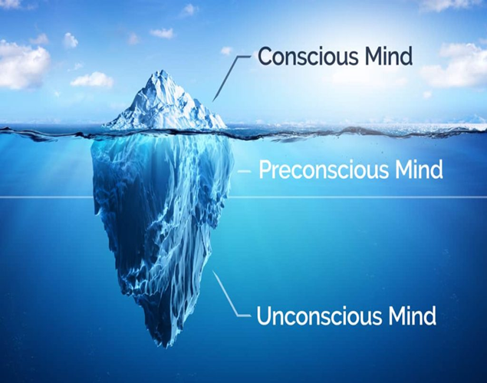
2. CONSCIOUS VS. UNCONSCIOUS MIND
How much of our behavior is produced by forces of which we are fully aware
and
How much is due to unconscious activity
– mental processes that are not accessible to the conscious mind

Slide 13
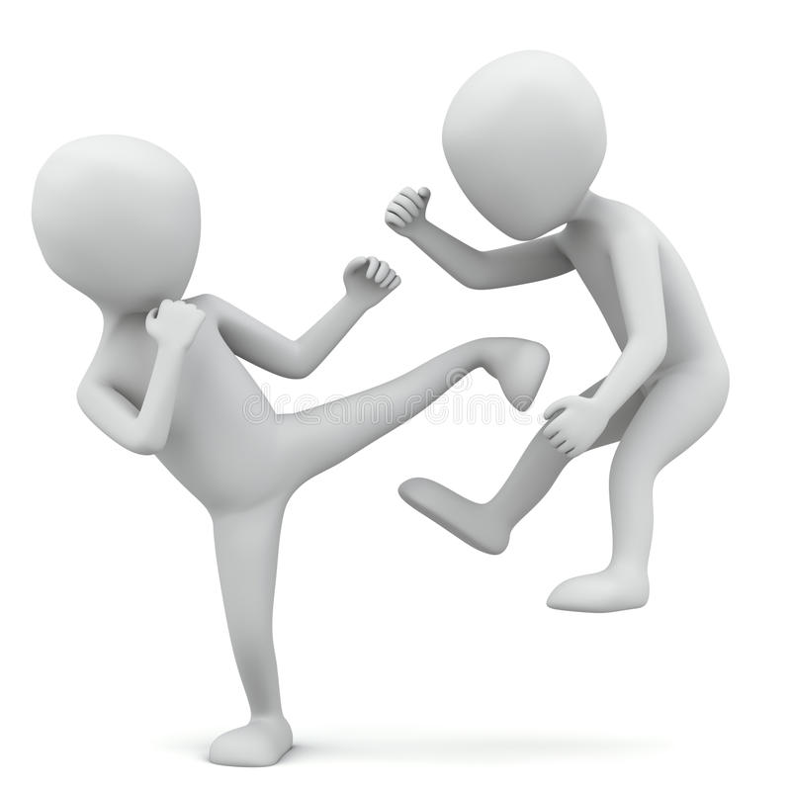
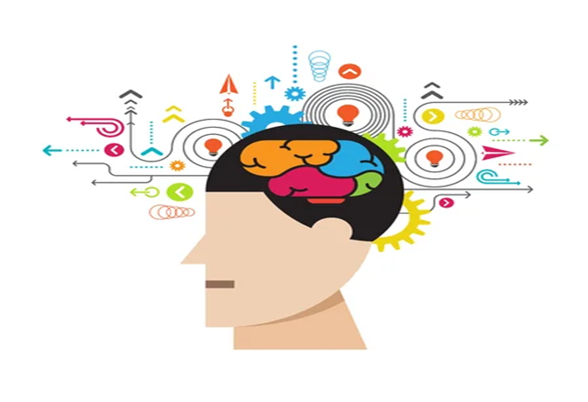
3. OBSERVABLE BEHAVIOR VS. INTERNAL MENTAL PROCESSES
Psychology should solely be concentrating on behavior that can be seen by outside observers
Behavioral psychologists think that the only source of information is behavior that can be observed directly
Psychology should focus on unseen thinking processes because according to cognitive psychologist what goes on inside a person’s mind is critical to understanding behavior.
OR

Slide 14

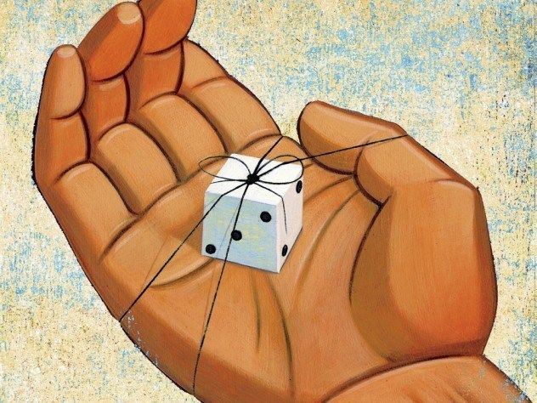
4. FREE WILL (CHOICES) VS. DETERMINISM
How much of our behavior is due to choices made freely by an individual?
We are free to choose our actions
How much is produced by factors beyond that individual’s voluntary control?
The assumption that everything that happens has a cause or determinant in the observable world.
Example: child born in a poor family, will live a poor life.
GENETIC AND ENVIRONMENT
OR

Slide 15
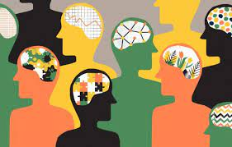
5. INDIVIDUAL DIFFERENCES VS. UNIVERSAL PRINCIPLES
Focus on the uniqueness of every individual.
Every person’s behavior is a reflection of their distinct and special individual qualities.
E.g.: learning style
Based on cultural and societal norms and values.
OR

Slide 16
BRANCHES OF PSYCHOLOGY
Clinical psychology
Counselling
Developmental psychology
Social psychology
School and Educational psychology
Industrial and Organizational psychology
Sports psychology
Forensic psychology
Health psychology

Slide 17
TOPIC 2 WEEK 1

Slide 18
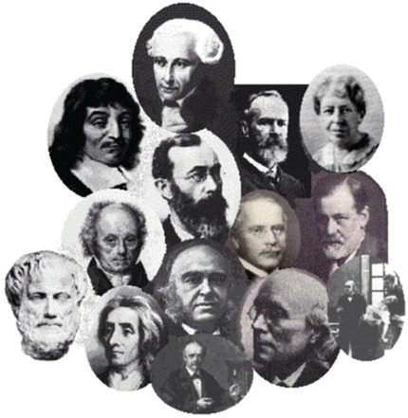
THE HISTORICAL ORIGINS OF
PSYCHOLOGY

Slide 19

SUPERNATURAL ELEMENTS
Before the age of scientific inquiry all good and bad manifestations beyond the control of human kind were regarded as supernatural.

Slide 20

EARLY DEMONOLOGY
The doctrine that a semi autonomous or completely autonomous evil being such as the devil may dwell within a person and control his or her mind and body is called demonology.

Slide 21
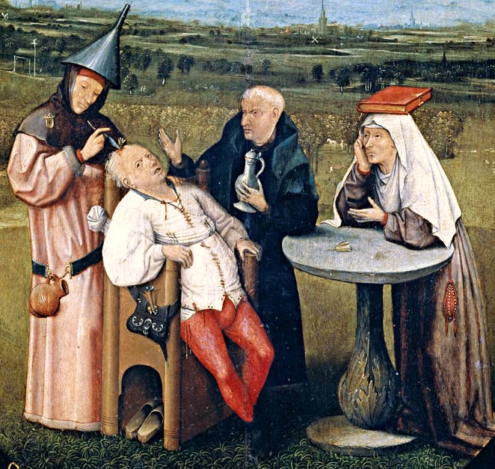
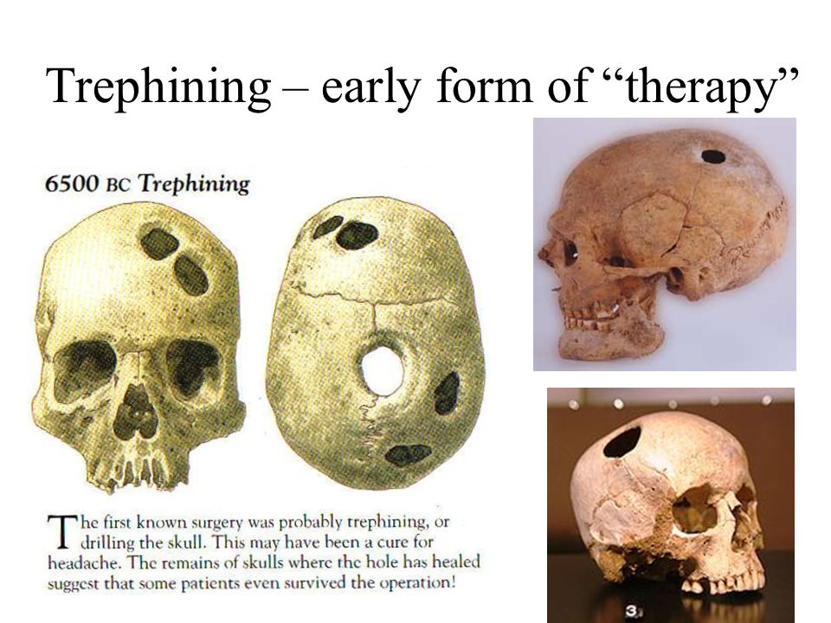
TREPHINING
People thought that psychological problems are caused by evil spirits.
To allow those spirits to escape from a person’s body the ancient healers chipped a hole in patient’s skull with crude instrument.

Slide 22
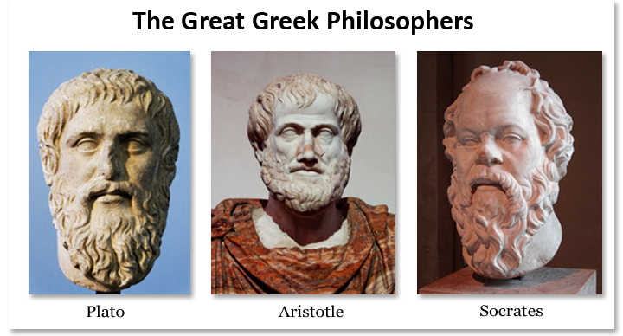
GREEK PHILOSOPHERS
Early Greek philosophers such as Socrates, Plato, and Aristotle explored topics such as pleasure, pain, knowledge, motivation, rationality, and mental illness—topics often discussed in psychology today.
Socrates, Plato, and Aristotle, posed fundamental questions about mental life: What is consciousness? Are people inherently rational or irrational? Is there really such a thing as free choice?

Slide 23

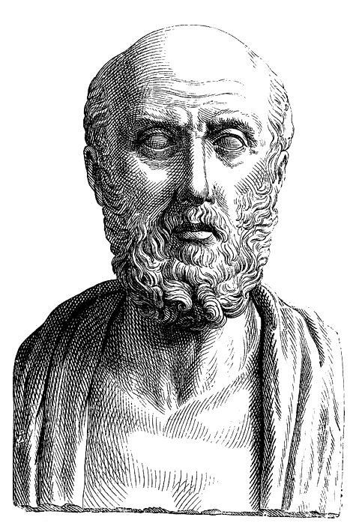
HIPPOCRATES
Hippocrates, often called the ‘father of medicine’, lived around the same time as Socrates.
He was deeply interested in physiology, the study of the functions of the living organism and its parts.
He made many important observations about how the brain controls various organs of the body.
These observations set the stage for what became the biological perspective in psychology

Slide 24
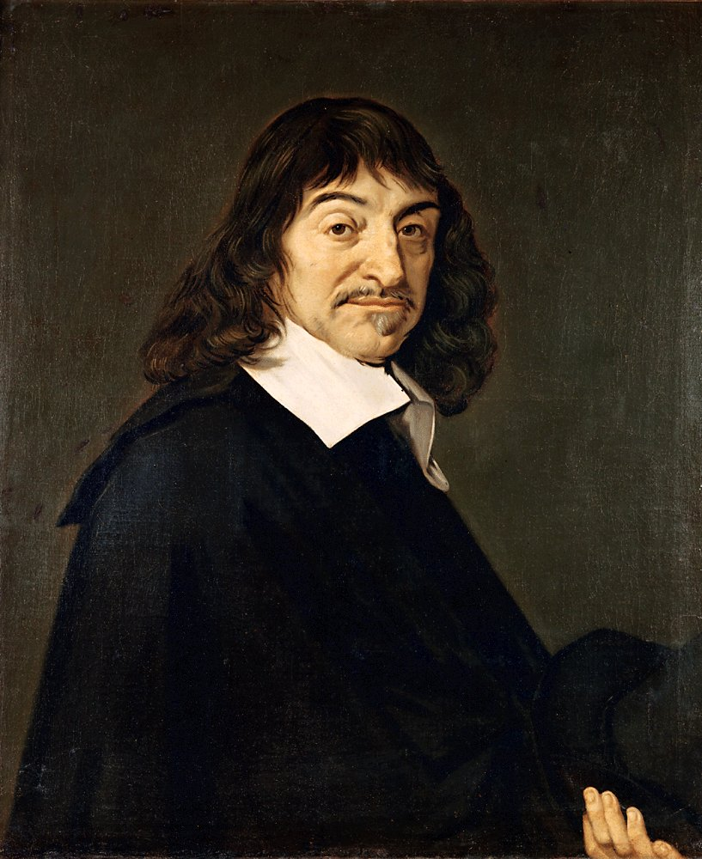
17TH CENTURY STARTS
In the 17th century, French mathematician and philosopher René Descartes theorized that the body and mind are separate entities. This concept came to be known as dualism

Slide 25
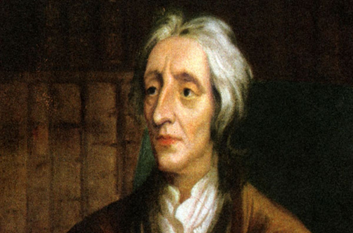
English philosopher John Locke
According to Locke, at birth the human mind is a tabula rasa, a blank slate on which experience ‘writes’ knowledge and understanding as the individual matures.

Slide 26
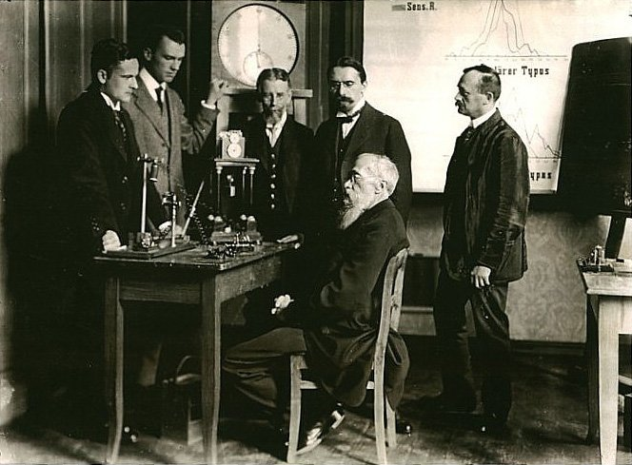
THE BEGINNINGS OF SCIENTIFIC PSYCHOLOGY
The field of psychology emerged as a scientific discipline in the 19th century, but its roots go back to ancient philosophy.
Wilhelm Wundt established the first psychological laboratory at the University of Leipzig in Germany in 1879. Wundt relied on introspection to study mental processes.
Father of Modern Psychology
Introspection refers to observing and recording the nature of one’s own perceptions, thoughts, and feelings.

Slide 27
Examples of introspections include people’s reports of how heavy they perceive an object to be and how bright a flash of light seems to be. The introspective method was inherited from philosophy, but Wundt added a new dimension to the concept. Pure self-observation was not sufficient; it had to be supplemented by experiments.
Wundt was important because he separated psychology from philosophy by analyzing the workings of the mind in a more structured way, with the emphasis being on objective measurement and control.
For example, participants would be exposed to a standard stimulus (e.g. a light or the sound of a metronome) and asked to report their sensations.

Slide 28
His work focused on consciousness – or the awareness of immediate experience.
Wundt's theory were developed and promoted by his one-time student, Edward Titchener, who described his system as Structuralism.

Slide 29
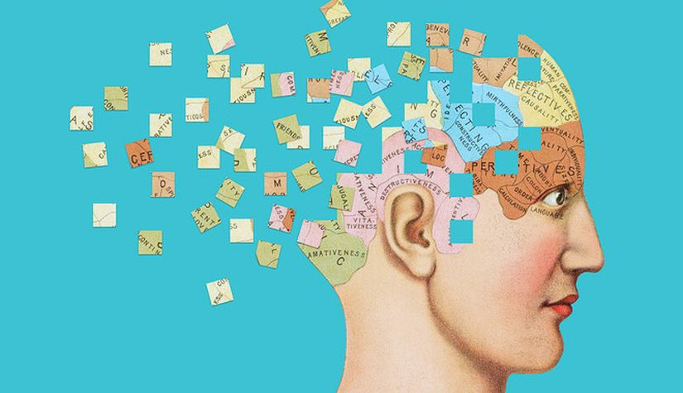
STRUCTURALISM
Edward Titchener, believed that the task of psychology was to analyze consciousness into its basic elements. These elements would include ideas like sensations, emotions, and images.
These investigations were based on introspection by trained subjects– careful, systematic self- observation of one’s own conscious experience.

Slide 30
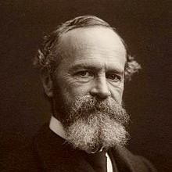
FUNCTIONALISM
Functionalism became popular with the publication of Principles of Psychology in 1890 by William James.
Functionalism is the idea that psychology should focus on the function or purpose of consciousness rather than its structure.

Slide 31
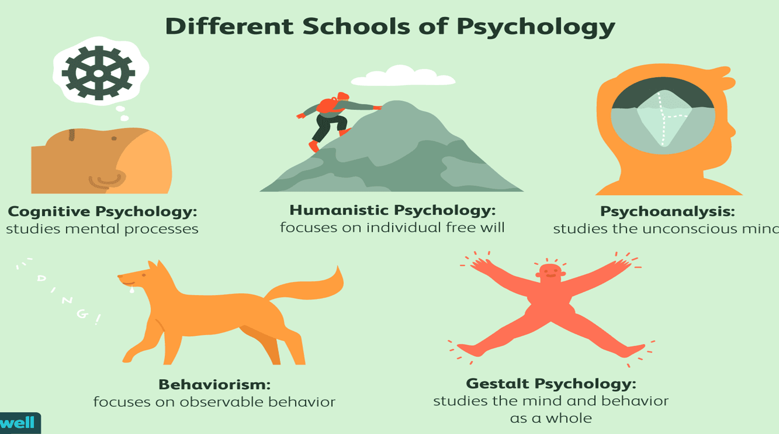

Slide 32

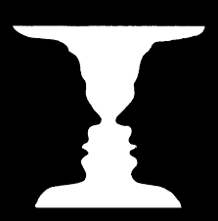
GESTALT PSYCHOLOGY

Slide 33


Slide 34
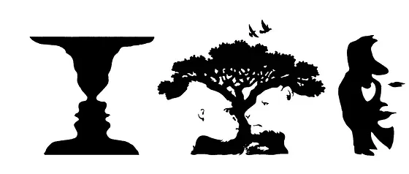

Slide 35

Max Wertheimer (1880–1943), Kurt Koffka (1886–1941), and Wolfgang Köhler (1887–1967) founded Gestalt psychology in the early 20th century.
The whole is different from the sum of its parts.
Our perception or understanding of objects is greater and more meaningful than the individuals elements that make up our perceptions.
Notes:
https://www.britannica.com/science/Gestalt-psychology

Slide 36
When trying to make sense of the world around us, Gestalt psychology suggests that we do not simply focus on every small component. Instead, our minds tend to perceive objects as part of a greater whole and as elements of more complex systems.
This school of psychology played a major role in the modern development of the study of human sensation and perception.

Slide 37

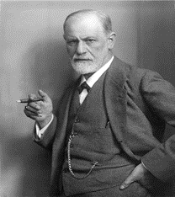
SIGMUND FREUD (1856-1939)
Austrian physician who founded the psychoanalytic approach to psychology.
Freud developed a theory based on the existence of the unconscious.
According to him emotional and behavioral disturbances were based on personal conflicts on an unconscious level.

Slide 38
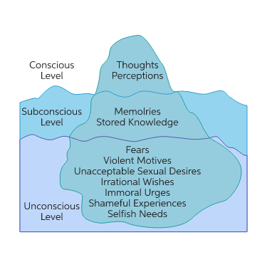
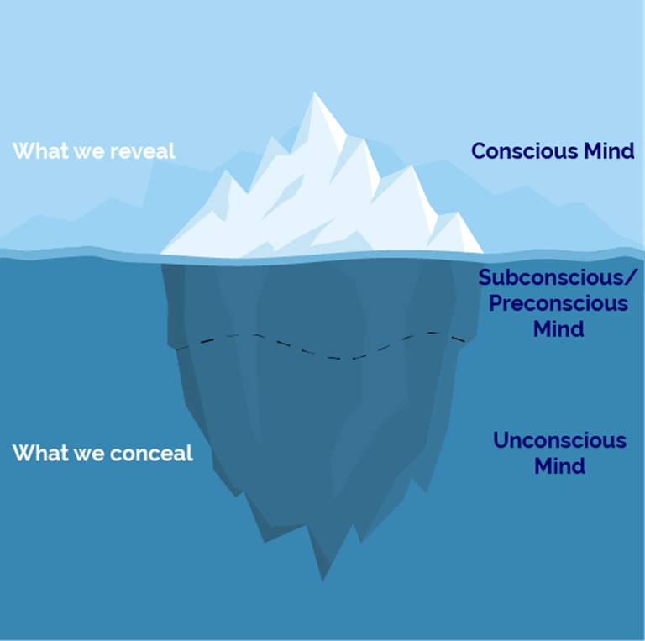
At the center of Freud’s theory is the concept of the unconscious – the thoughts, attitudes, impulses, wishes ,motivations, and emotions of which we are unaware.
Childhood’s unacceptable (forbidden or punished) wishes are driven out of conscious awareness and become part of the unconscious, where they continue to influence our thoughts, feelings, and actions.
Unconscious thoughts are
expressed in dreams, slips of the
tongue, and physical mannerisms.

Slide 39
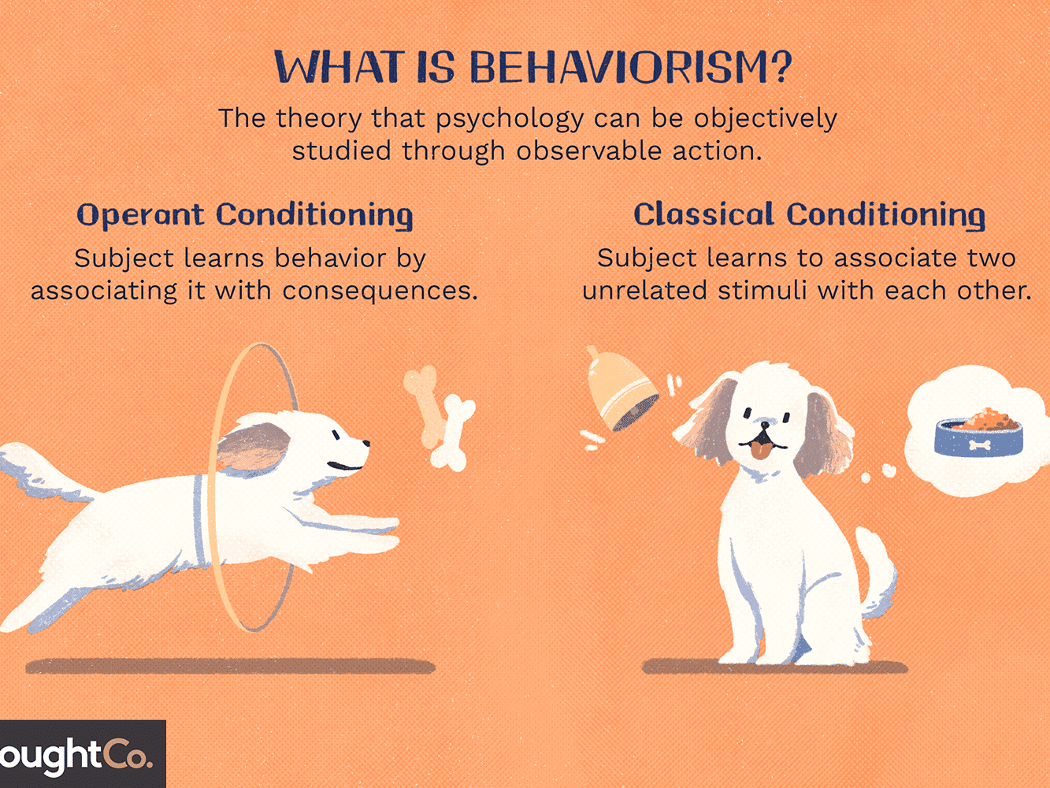
BEHAVIORISM
John B. Watson, in 1913 and others ascribing to behaviorism, argued that nearly all behavior is a result of conditioning and the environment shapes behavior by reinforcing specific habits.
It stated that scientists should only study observable behavior and that consciousness should be abandoned because ultimately consciousness and perceptions are private events and cannot be objectively verified.
This means that psychology would suffer from a lack of reliability.
Top names:
B.F Skinner
Ivan Pavlov

Slide 40
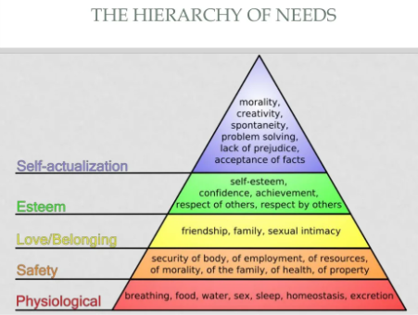
HUMANISTIC PERSPECTIVE
Humans are capable of incredible acts of creativity, selflessness & high levels of spirituality.
Free will
Main figures:
Carl Rogers , Abraham Maslow

Slide 41
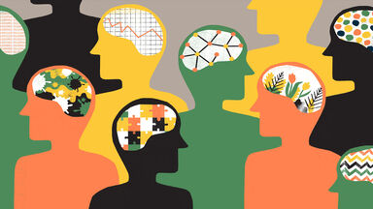
COGNITIVE PERSPECTIVE
Focus on Mental processes
Perceiving, remembering, reasoning, deciding, and problem solving
Only by studying mental processes can we fully understand what organisms do.

Slide 42
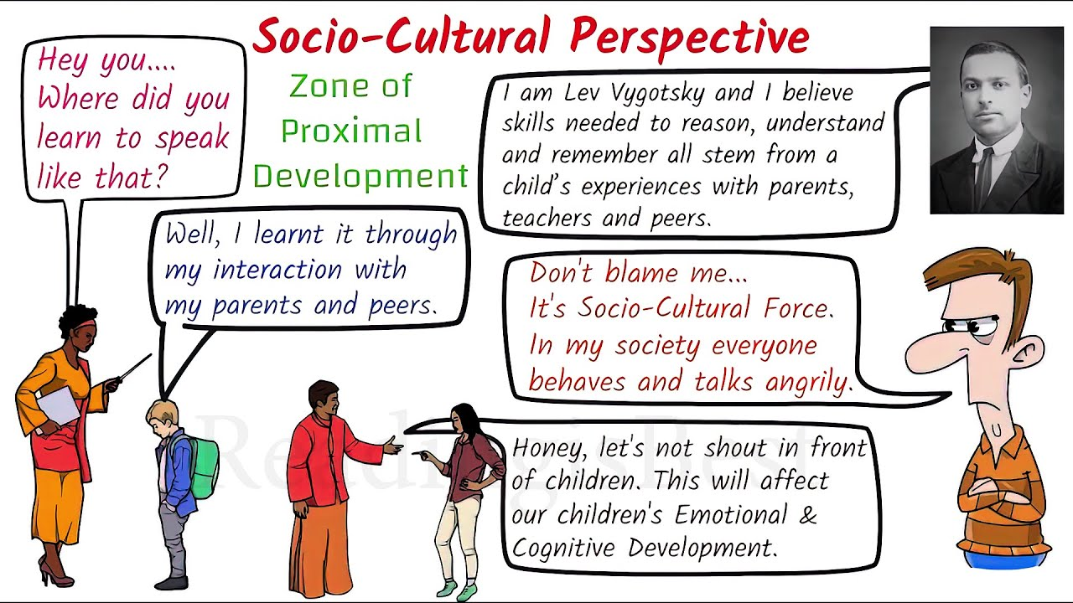
SOCIO-CULTURAL PERSPECTIVE
Sociocultural theory is an emerging theory in Psychology that looks at the important contributions that society makes to individual development.
Sociocultural theory focuses not only how adults and peers influence individual learning, but also on how and attitudes affect how learning takes place. cultural beliefs
This theory stresses the interaction between developing people and the culture in which they live.
Sociocultural theory also suggests that human learning is largely a social process.

Slide 43
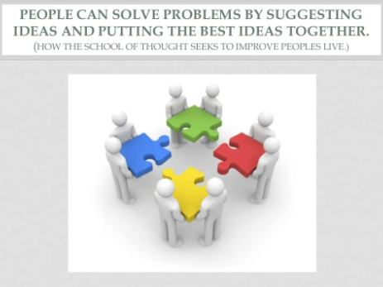
ECLECTIC APPROACH
Selecting and adopting information from many different sources rather than relying on one perspective.

Slide 44
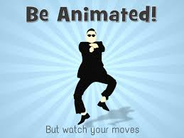

The end

